Slide 1
Social and Emotional Health K-12 Health Education Learning Standards
SELB Workgroup
Renton Technical college
November 30, 2015

Slide 2

Meeting Targets
Share background on standards writing process
Review Draft Social and Emotional Health Standards and Outcomes
Solicit feedback from SELB
Answer Guiding Questions
An
Notes:
Feedback – positive, overarching considerations, outcomes revisions/justifications
This is an opportunity; it won’t be perfection
Keep the big picture in mind

Slide 3
Definitions
Essential Academic Learning Requirements (EALRs) – Required elements of instruction for teaching and learning as specified in the Basic Education Act (RCW 28A.150.210)
Standards – Required and broad-reaching expectations for teaching and learning
Outcomes – Grade-level expectations; what students should know and be able to do; age-appropriate guidance to reach standards
Core Idea – One of six subject areas within Washington’s K-12 Health Education Learning Standards

Slide 4
Guiding Questions
How can new standards and outcomes positively impact the delivery of social and emotional health education?
What critical gaps exist in these draft Social and Emotional Health Education Standards?
How do these new Social and Emotional Health Education Standards impact and relate to the work of this group?
What can we provide (SELB Workgroup) to schools to strengthen implementation?

Slide 5
OSPI – Who We Are
Our mission:
Every student ready for career, college, and life.
Performance Indicators:
OSPI staff align their goals with research-based performance indicators.
Our vision:
To provide funding, resources, tools, data and technical assistance that enable educators to ensure students succeed in our public schools, are prepared to access post-secondary training and education, and are equipped to thrive in their careers and lives.
Goals are reviewed by the superintendent three times per year to ensure our work leads directly to student success.

Slide 6
Revising the K-12 Health and Physical Education Learning Standards
OSPI required to develop state learning standards (RCW 28A.150.210)
Revision schedule (7-8 years is typical)
Last adopted in 2008
Align with state laws
Adoption of common core
New national standard sets
Notes:
Lisa

Slide 7

District Requirements
Basic Education Act – Each school district, with the involvement of parents and community members, shall be to provide opportunities for every student to develop the knowledge and skills essential to…know and apply the core concepts and principles of…health and fitness.
Graduation Requirement - .5 credits (semester) of Health Education

Slide 8
Big Picture
Educational
Equity
High-Quality Instruction and Professional Development
Health and Academic Needs of Students
Notes:
Marissa

Slide 9
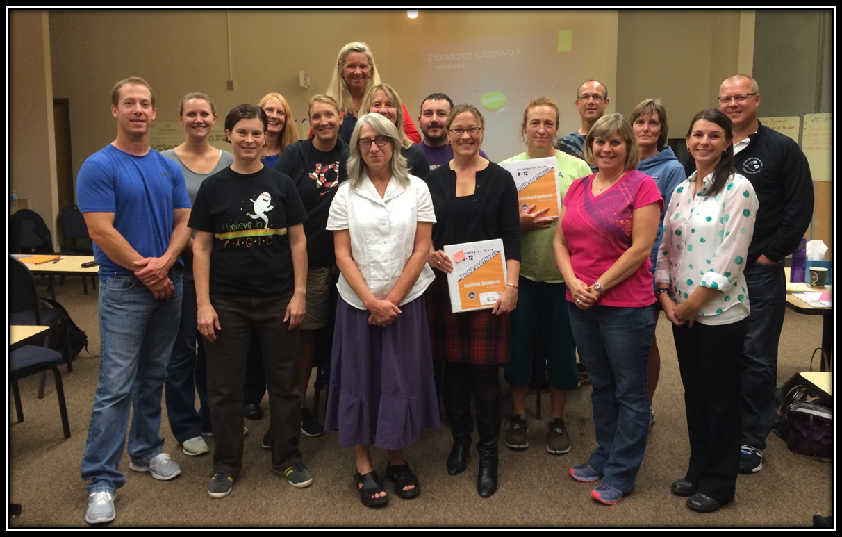
HPE Writing Team
Notes:
Lisa

Slide 10

Process 2014-2016
Monthly, two-day writing meetings
September 2014 – July 2015
Virtual writing meetings
May – August 2015
Curriculum Advisory Review Committee (CARC)
November 2013 – January 2016
Bias & Sensitivity Reviews
June – July 2015
Internal and Close Friends Review
May – October 2015
Final review – HPE Writing Team Meeting
October 2015
Public Comment Period
December 2015 – January 2016
Notes:
Lisa

Slide 11
Positive feedback
“This document is structured really well. It’s very clear.”
“Core ideas are good.”
“Nutrition is included in both PE and HE – yes!”
“Clean and much easier to follow strands/outcomes.”
“Easy to follow – nice and broad to implement to various needs/districts.”

Slide 12

Structure and Key Decisions
Adopted National Health Education Standards
Require implementation of Standards (formerly EALRs)
Grade-level outcomes to guide teaching and learning
Revised formatting
Separated Health and Physical Education
Six Core Ideas, including Social and Emotional Health
Notes:
Marissa

Slide 13
Other Considerations
National standard set alignments
Depth of Knowledge (DOK)
Backwards design
Current research, laws, and language
Front matter, glossary, appendices
State examples and models
Gradual evolution
Notes:
Marissa

Slide 14

National Health Education Standards
Students will:
1. Comprehend concepts related to health promotion and disease prevention to enhance health.
2. Analyze the influence of family, peers, culture, media, technology, and other factors on health behaviors.
3. Demonstrate the ability to access valid information and products and services to enhance health.
4. Demonstrate the ability to use interpersonal communication skills to enhance health and avoid or reduce health risks.
5. Demonstrate the ability to use decision-making skills to enhance health.
6. Demonstrate the ability to use goal-setting skills to enhance health.
7. Demonstrate the ability to practice health-enhancing behaviors and avoid or reduce health risks.
8. Demonstrate the ability to advocate for personal, family, and community health.
Notes:
Marissa
1 – knowledge 2-8 – Skill-building
Not topic specific

Slide 15
Core Idea Development: Social and Emotional Health
K-12 health education teacher expertise
Collaborative for Academic, Social and Emotional Learning (CASEL) Model
State and District Examples (e.g., Illinois, Bellevue, Oregon, California)
Health Education Textbooks
State law
2008 Washington State Health and Fitness EALRs

Slide 16
Key Features of Social Emotional Learning (SEL)
Free-standing
Comprehensive
Integrated
Supports teaching practices
Enhances school climate
Culturally sensitive
Linguistically appropriate
Strengthens implementation
Source: http://www.casel.org/library/2014/2/10/key-features-of-high-quality-standards-for-sel

Slide 17
Topic Strands: Social and Emotional Health
Elementary (K-5)
Secondary (6-HS)
Self-esteem
Body Image
Stress Management
Expressing Emotions
Harassment, Intimidation, and Bullying
Self-esteem
Body Image and Eating Disorders
Stress Management
Expressing Emotions
Harassment, Intimidation, and Bullying
Emotional and Mental/Behavioral Health

Slide 18
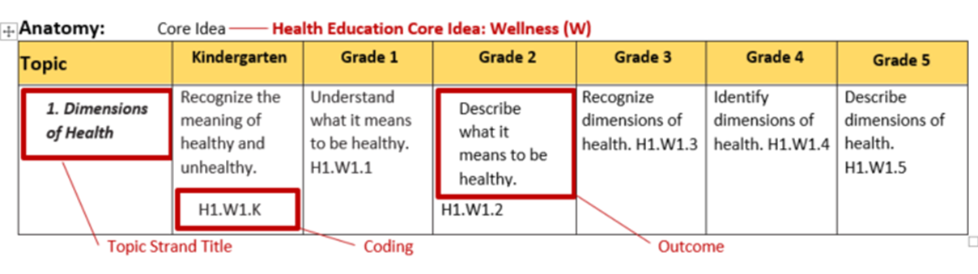
Format
1. Dimensions of Health
Describe what it means to be healthy.
1. Dimensions of Health
Describe what it means to be healthy.
H1.W1.K
H1.W1.K
Notes:
Lisa
Anatomy of a topic strand and outcome

Slide 19
SELB Review – Standards, Outcomes, and Glossary
Highlight – Highly support
Circle – Concerned; outside of field norms/language/expectations
Underline – Questions
OR
http://sgiz.mobi/s3/Health-and-Physical-Education-Standards-Review-2015

Slide 20
Next steps
Finalize Draft HPE Package
Select Copy Editor
Distribute Public Comment Survey
Public Comment Period (December – January)
Revise Based on Feedback
CARC GoToMeeting (January 2016)
Adopt (February 2016)

Slide 21
Implementation Timeline
PHASE 1
(2015-2016)
Awareness, Adoption and Capacity Building
PHASE 2
(2016 – 2017)
Piloting, PD, and Leveraging Resources
PHASE 3
(2017 – 2018)
Statewide Implementation
PHASE 4
(2018 – 2019)
Assessment and Coordination

Slide 22
Guiding Questions
How can new standards and outcomes positively impact the delivery of social and emotional health education?
What critical gaps exist in these draft Social and Emotional Health Education Standards?
How do these new Social and Emotional Health Education Standards impact and relate to the work of this group?
What can we provide (SELB Workgroup) to schools to strengthen implementation?

Slide 23
Contacts
Marissa Rathbone, MAT
Program Supervisor
Health and Physical Education
Office of Superintendent of Public Instruction
360.725.4977
marissa.rathbone@k12.wa.us

